Slide 1
CHƯƠNG 4: Cloud Platform Architecture
Cloud
Computing
Khoa CNNTT
GV: Vũ Quốc Hưng
Email : hungvq@vaa.edu.vn

Slide 2
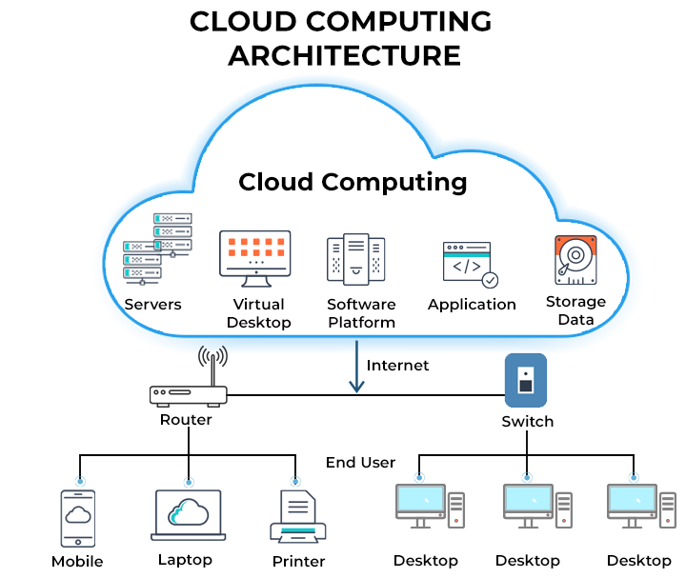
Introduction to Cloud Computing
https://en.wikipedia.org/wiki/Cloud_computing
The United States National Institute of Standards and Technology's definition:
On-demand self-service.
Broad network access.
Resource pooling.
Rapid elasticity.
Measured service.
In resource management, pooling is the grouping together of resources (assets, equipment, personnel, effort, etc.) for the purposes of maximizing advantage or minimizing risk to the users

Slide 3
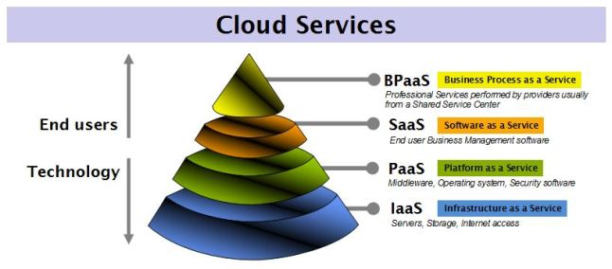
Cloud Service Models
1. Infrastructure as a Service (IaaS) 2. Platform as a Service (PaaS) 3.Software as a Service (SaaS) 4.Business Process as a Service (BPaS)

Slide 4
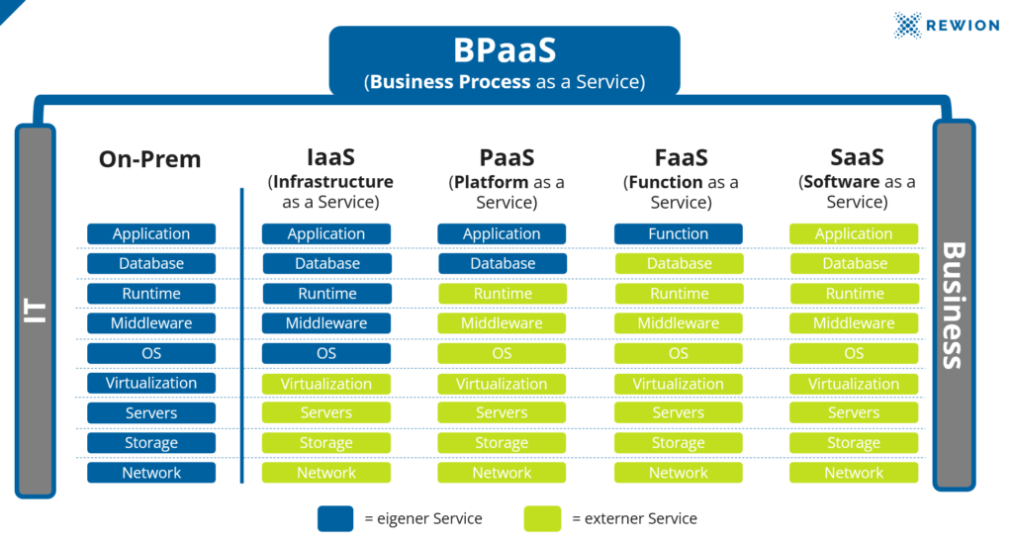
Cloud Service Models
You manage
Provider manages

Slide 5
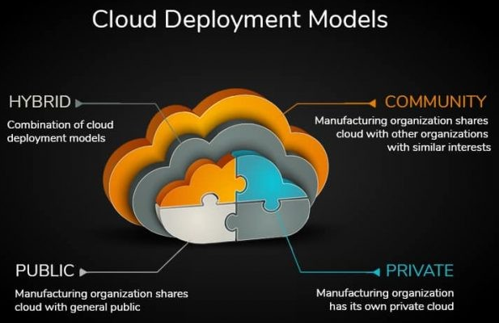
Cloud Deployment Models
1. Public Cloud 2. Private Cloud 3. Hybrid Cloud 4. Community Cloud

Slide 6
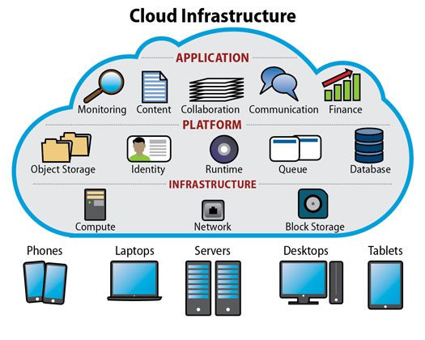
Cloud Platform Components
1. Compute resources (Virtual Machines, Containers) 2. Storage services (Object Storage, Block Storage) 3. Networking components (Load Balancers, Virtual Networks)

Slide 7
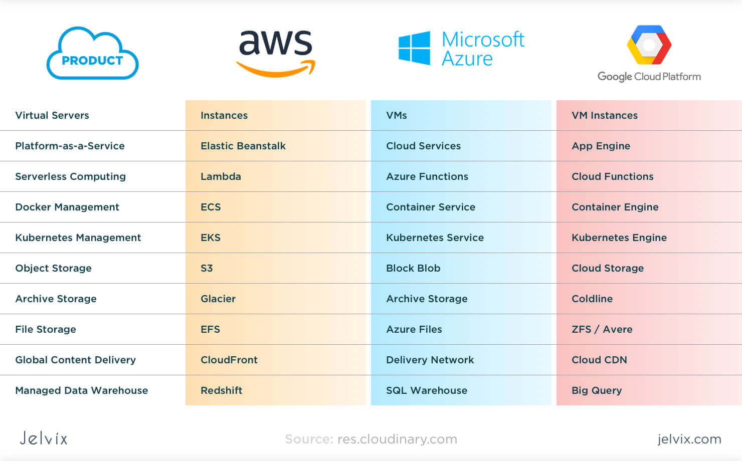

Slide 8
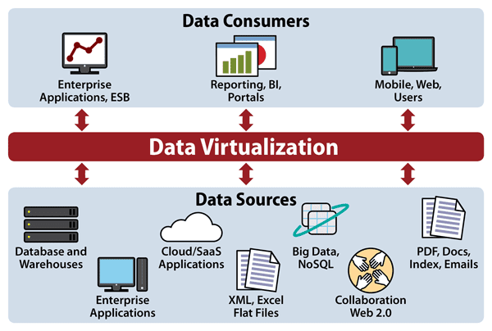
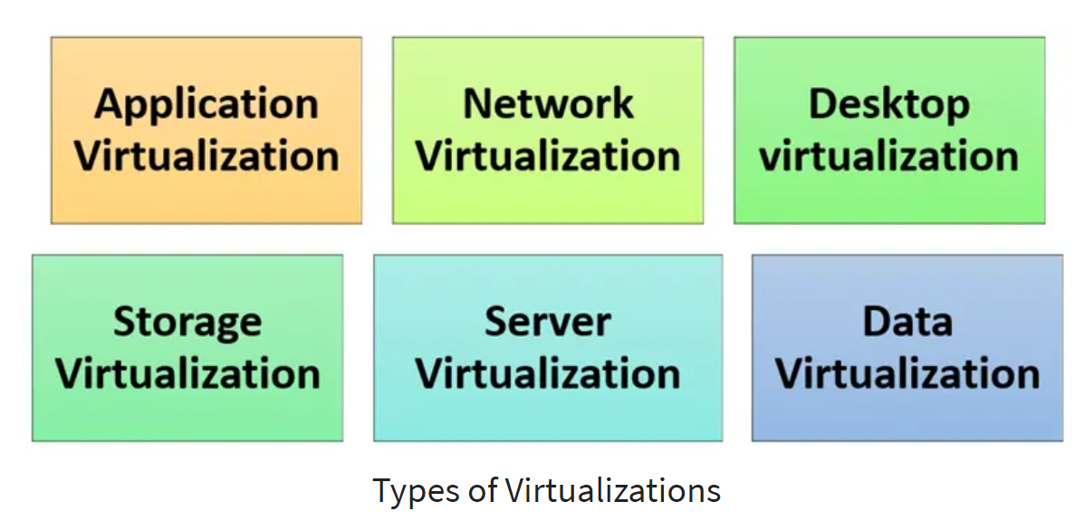
Virtualization in Cloud
1. Role of virtualization in cloud computing 2. Benefits and efficiency gains

Slide 9
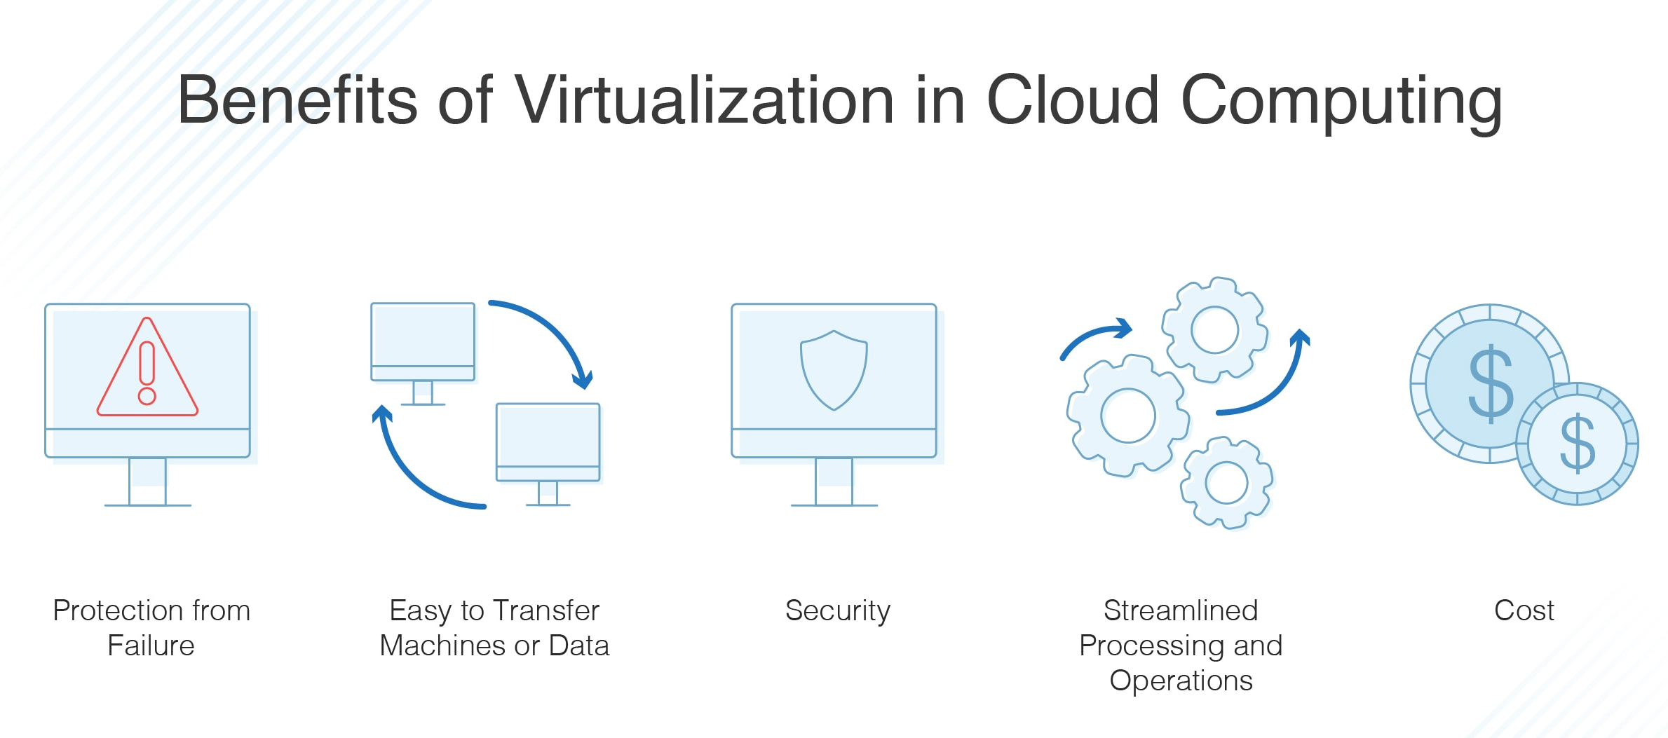
Virtualization in Cloud
1. Role of virtualization in cloud computing 2. Benefits and efficiency gains

Slide 10

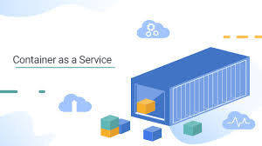
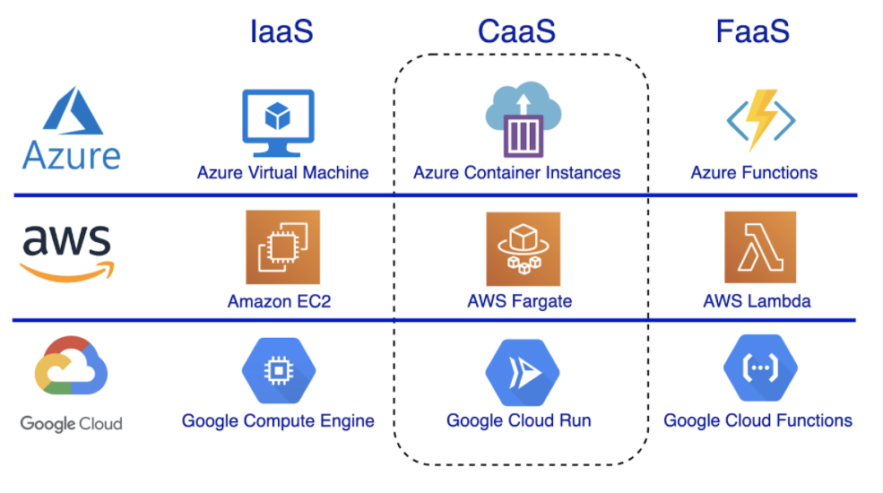
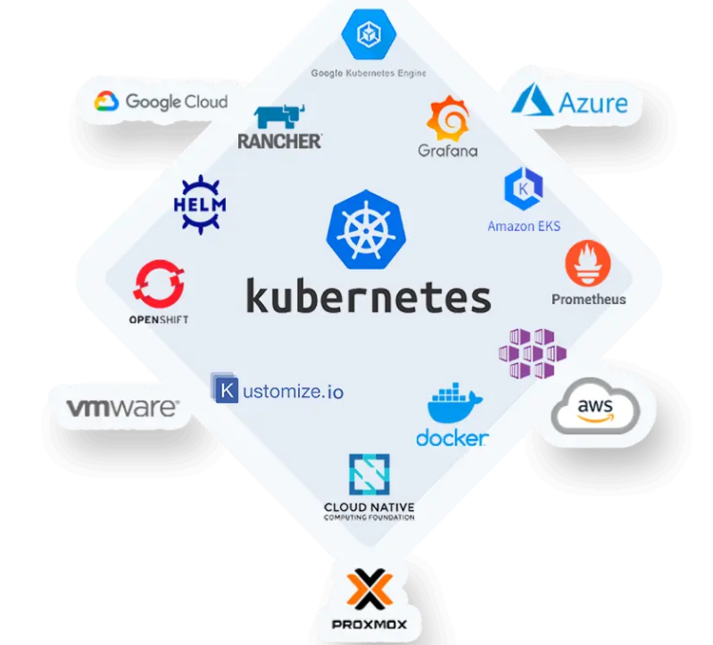
Containerization and Orchestration
1. Containers - Docker container - LXC…
2. Orchestration tools - Docker Swarm - Kubernetes - Proxmox…

Slide 11
Cloud Security Principles
Data encryption
Identity and Access Management (IAM)
Security groups and firewalls

Slide 12
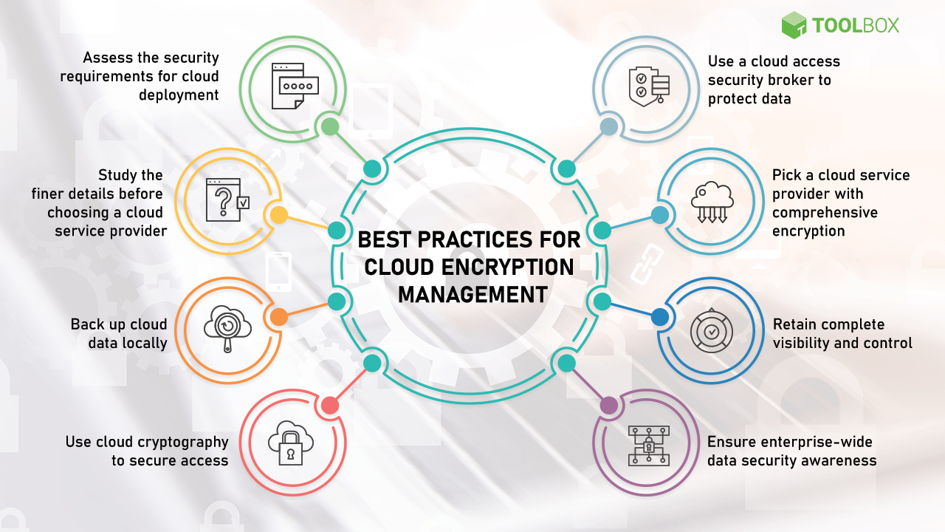
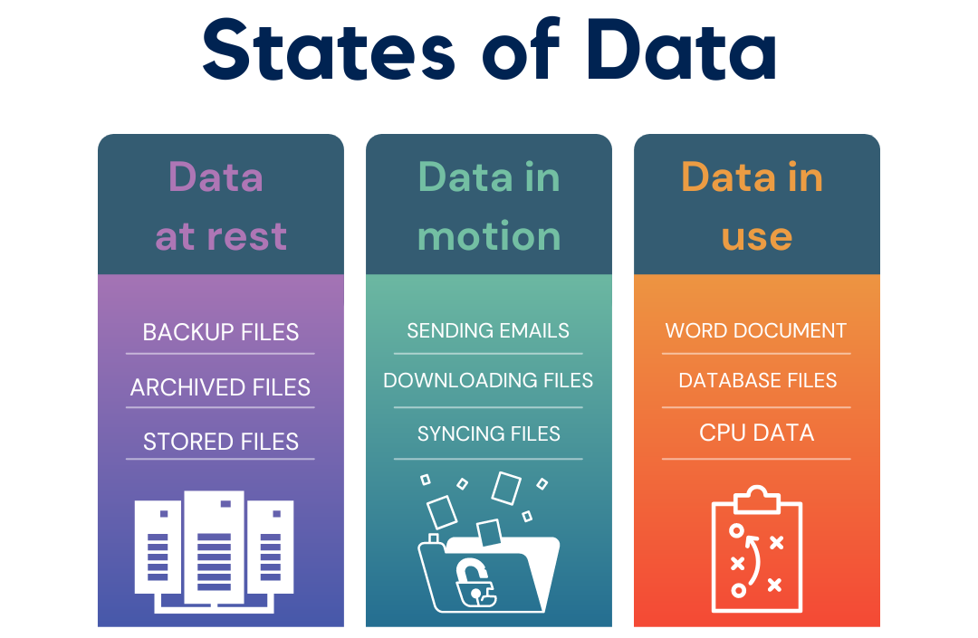
Cloud Security Principles
Data encryption

Slide 13
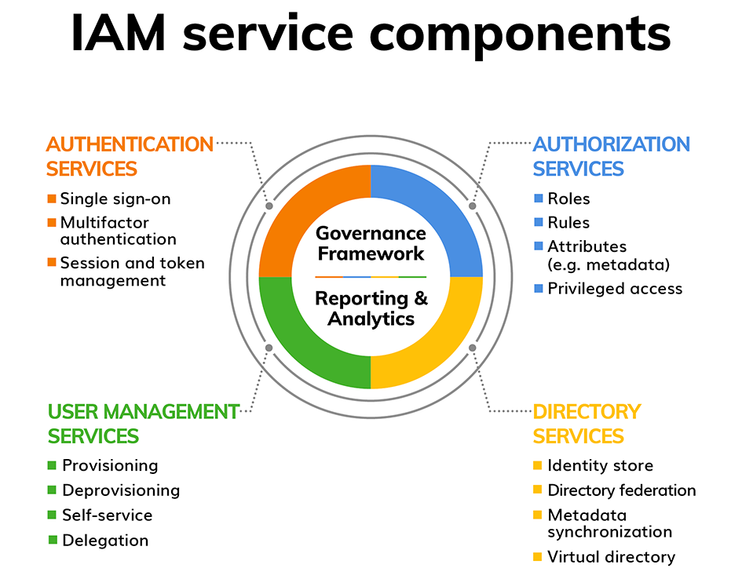
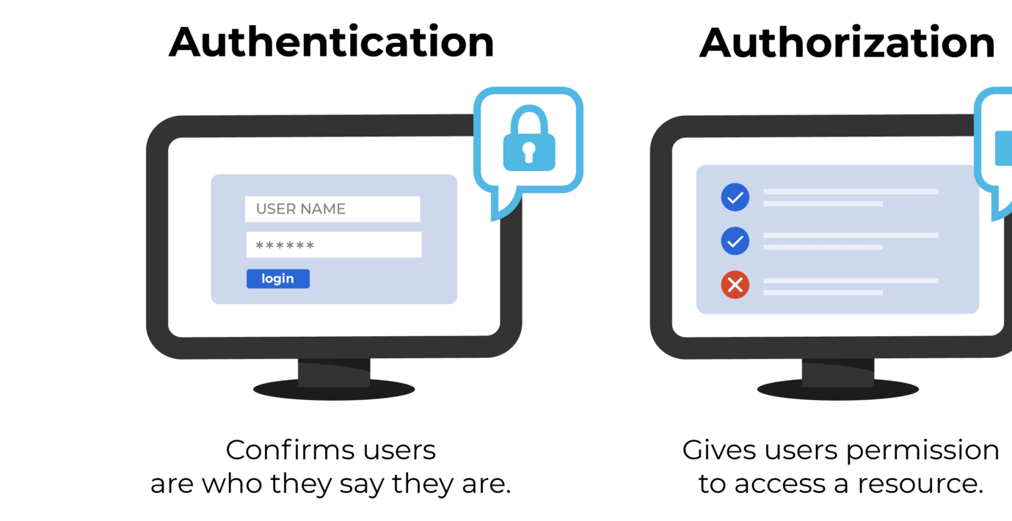
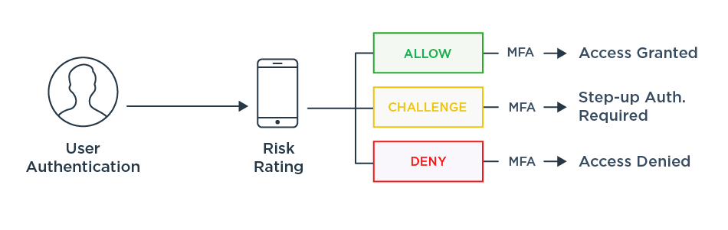
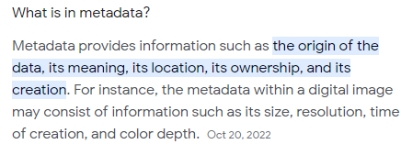
Cloud Security Principles
Identity and Access Management (IAM)

Slide 14
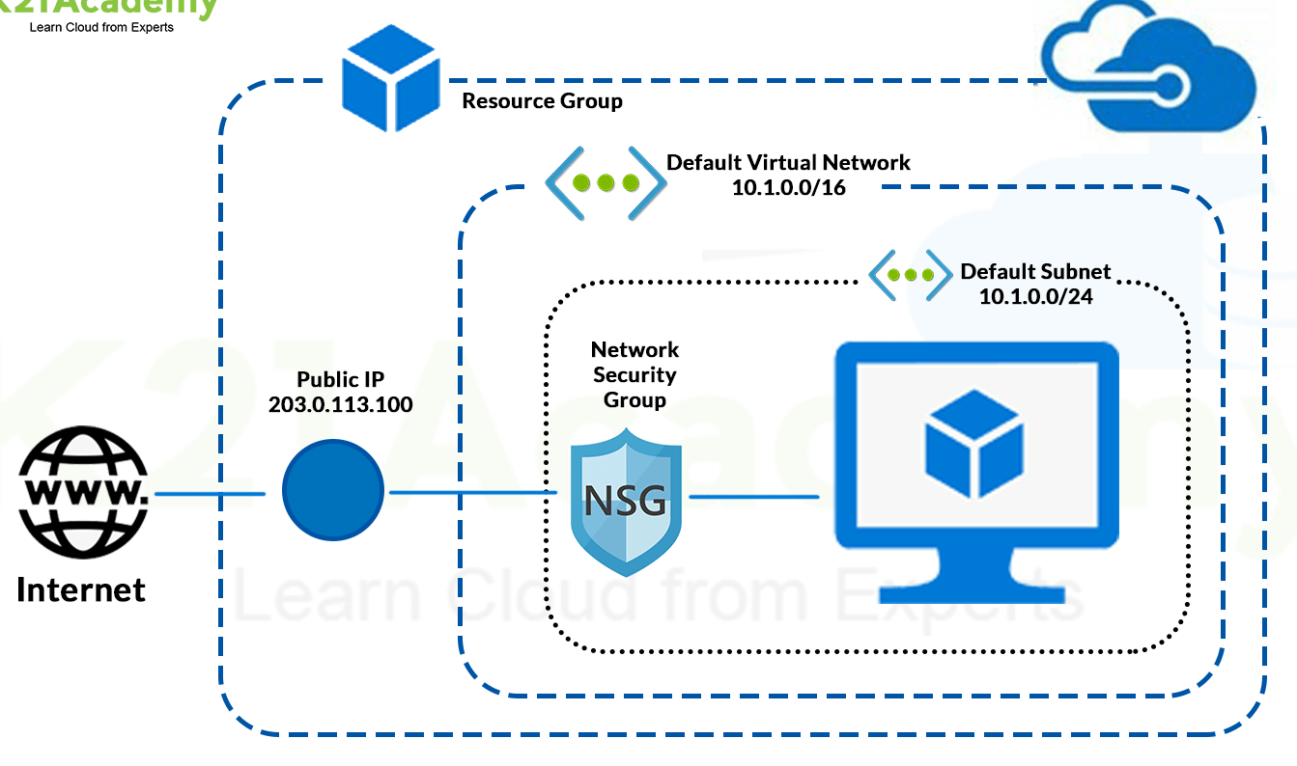
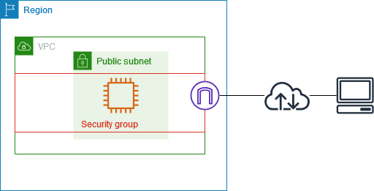
Cloud Security Principles
3. Security groups and firewalls
A security group controls the traffic that is allowed to reach and leave the resources that it is associated with
A security group acts as a virtual firewall
https://docs.aws.amazon.com/vpc/latest/userguide/vpc-security-groups.html

Slide 15
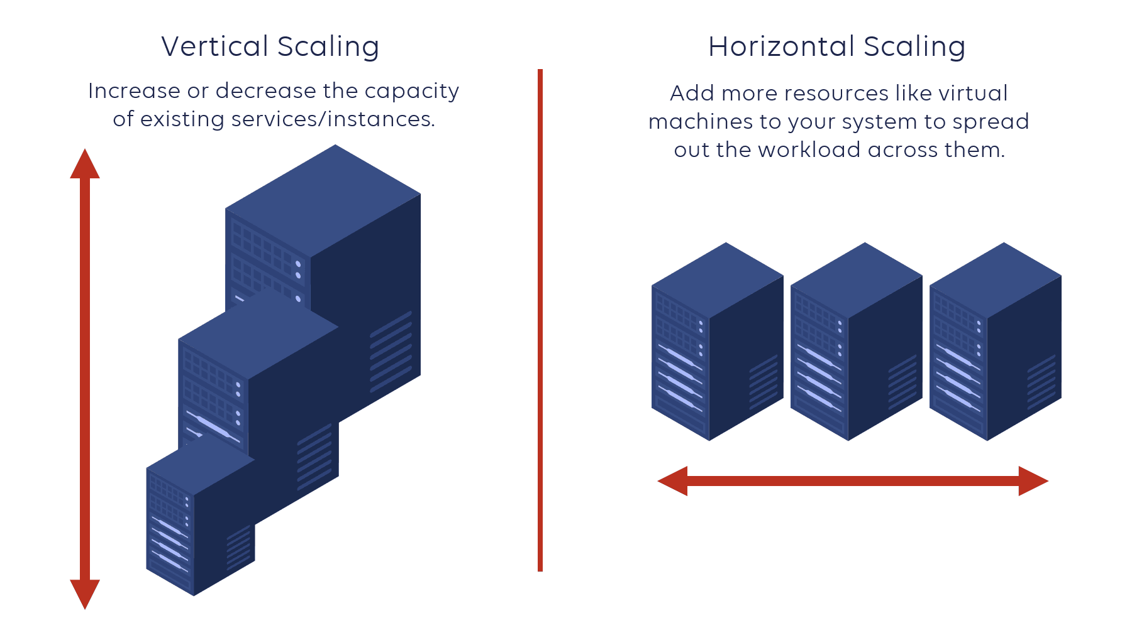
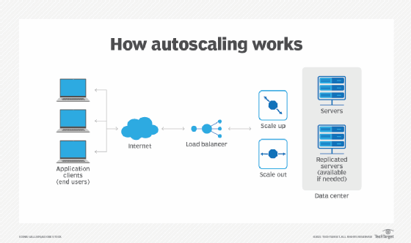
Scalability in the Cloud
1. Horizontal vs. Vertical Scaling
2. Auto-scaling features Enables cloud application workloads and services to deliver the optimum performance and accessibility service levels necessary under different conditions.

Slide 16
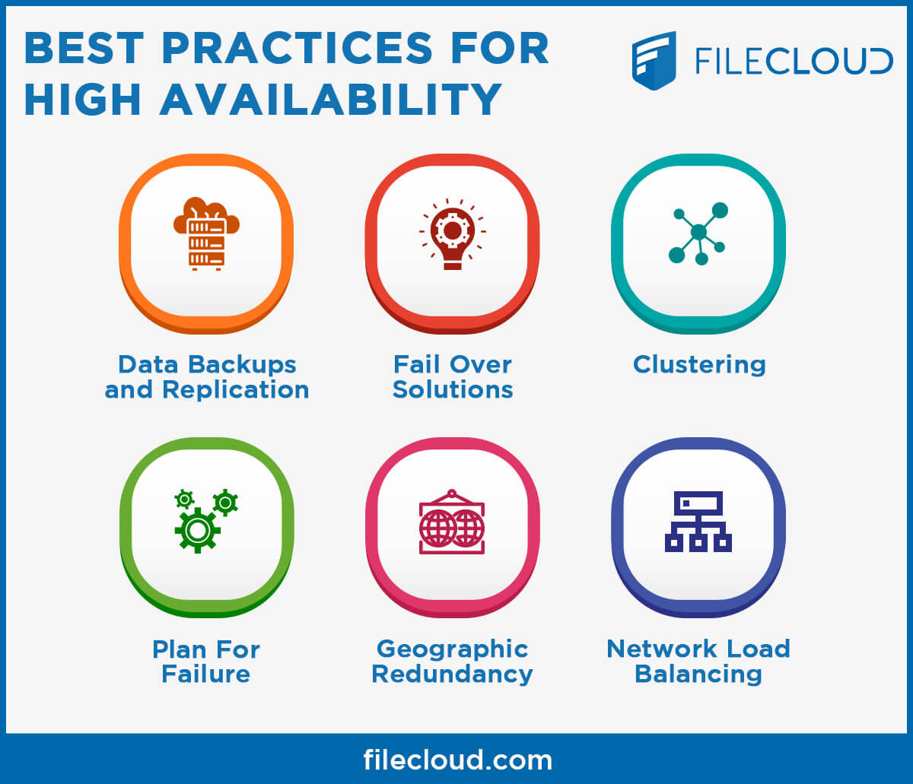
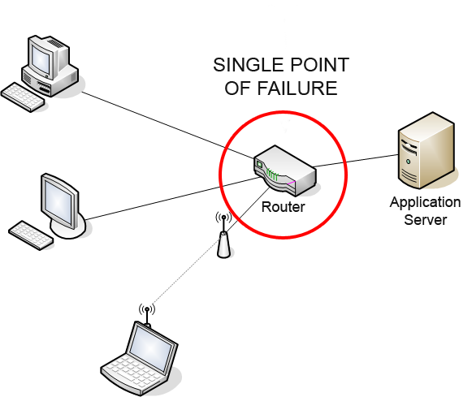
High Availability (HA) and Redundancy
1. Importance of HA

Slide 17
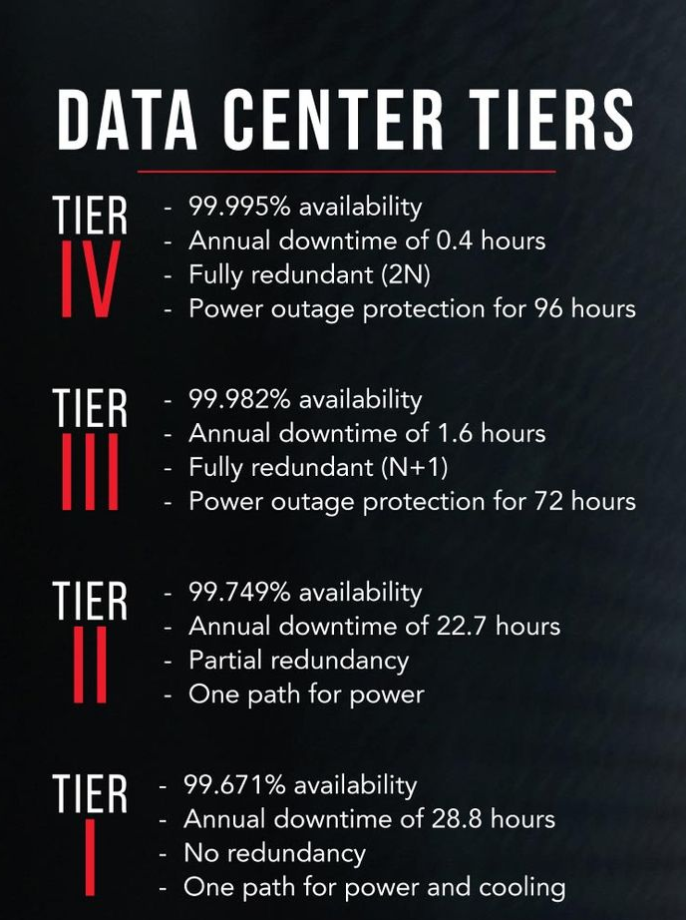
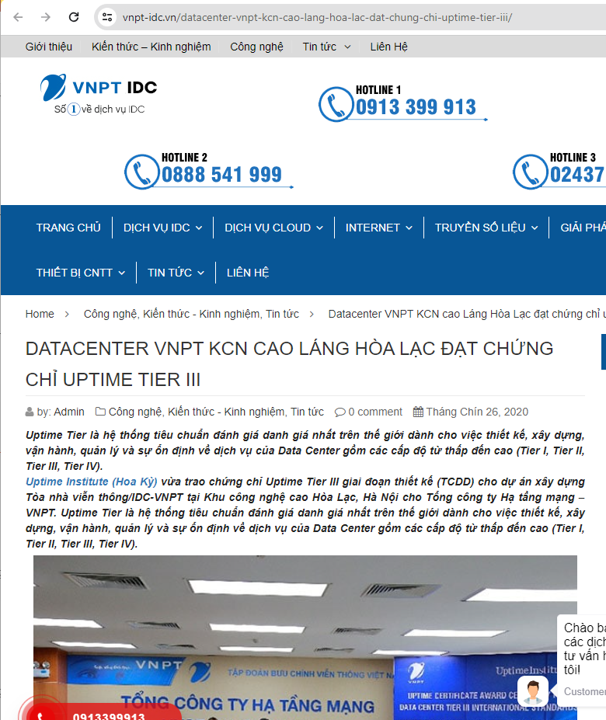
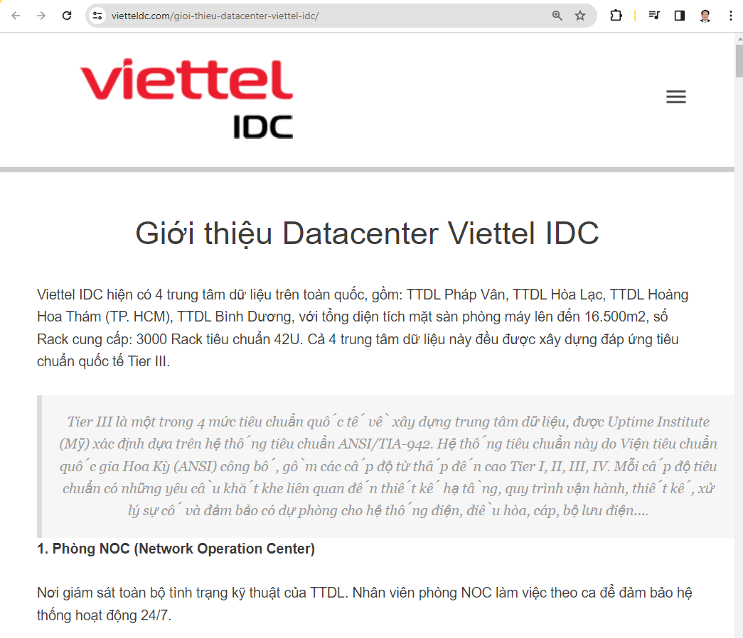
High Availability (HA) and Redundancy
2. Redundancy strategies ➔ N+ 1 Redundancy Strategies?
"N+1" in redundancy terms dictates the concept of having a backup option in place for every possible failure. In many cases, the best potential colocation providers go beyond "N+1" to build in additional redundancies.
1. Internet Connectivity
2. Power
3. Cooling
4. Locations and Backups

Slide 18
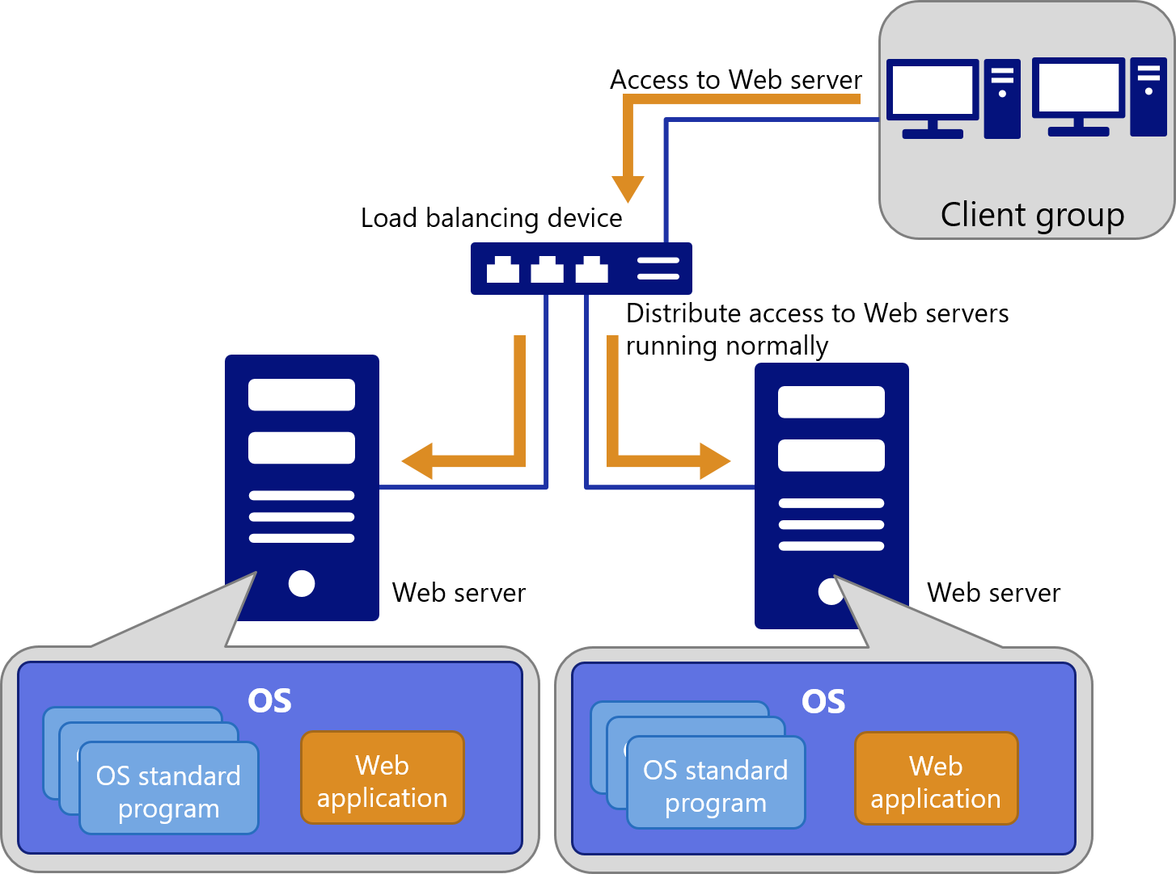
High Availability (HA) and Redundancy
2. Redundancy strategies ➔ N+ 1 Redundancy Strategies?

Slide 19
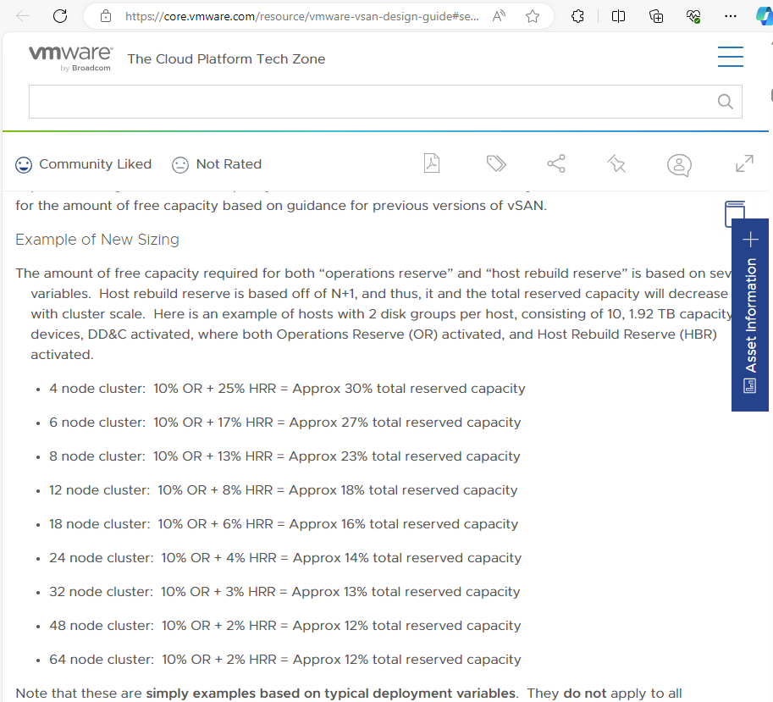
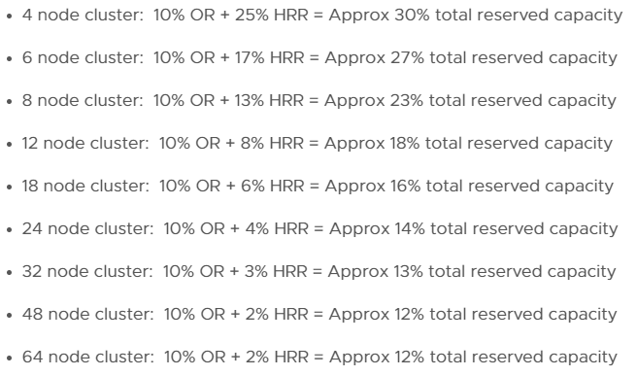
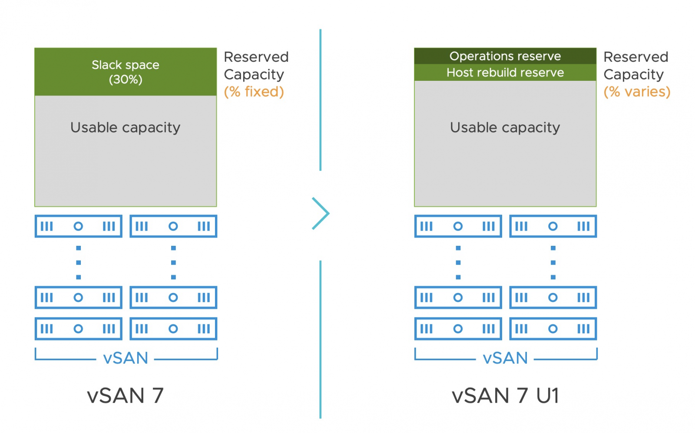
High Availability (HA) and Redundancy
2. Redundancy strategies ➔ N+ 1 Redundancy Strategies?

Slide 20
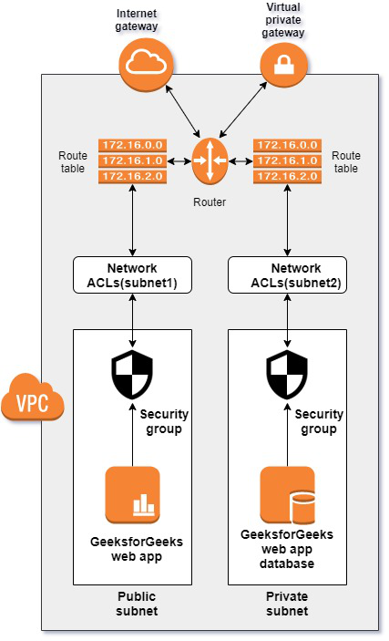
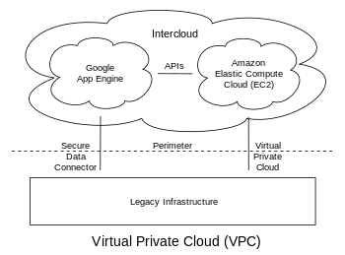
Network Infrastructure in the Cloud
1. Virtual Private Cloud (VPC) An on-demand configurable pool of shared resources allocated within a public cloud environment, providing a certain level of isolation between the different organizations (denoted as users hereafter) using the resources.
2. Subnets, Routing, and Gateways

Slide 21
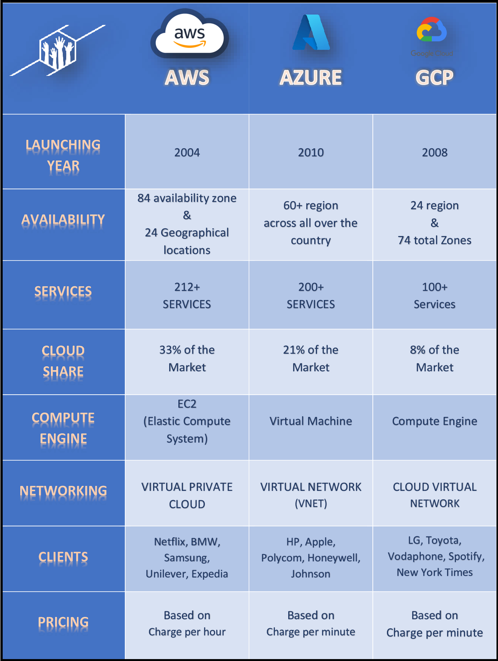
Network Infrastructure in the Cloud

Slide 22
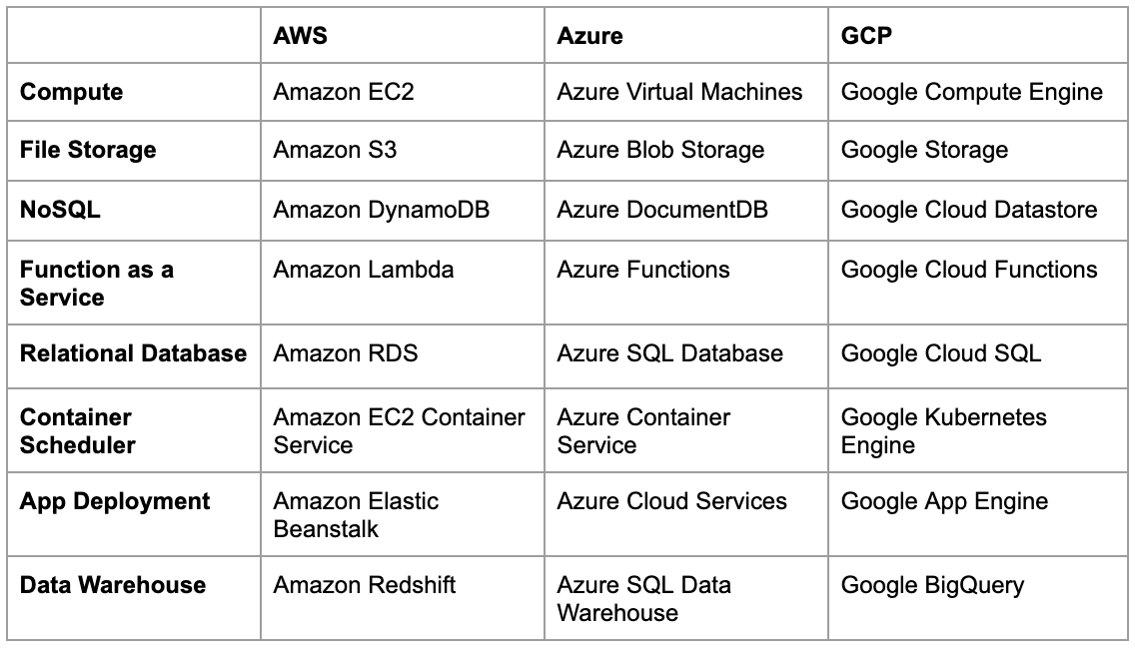
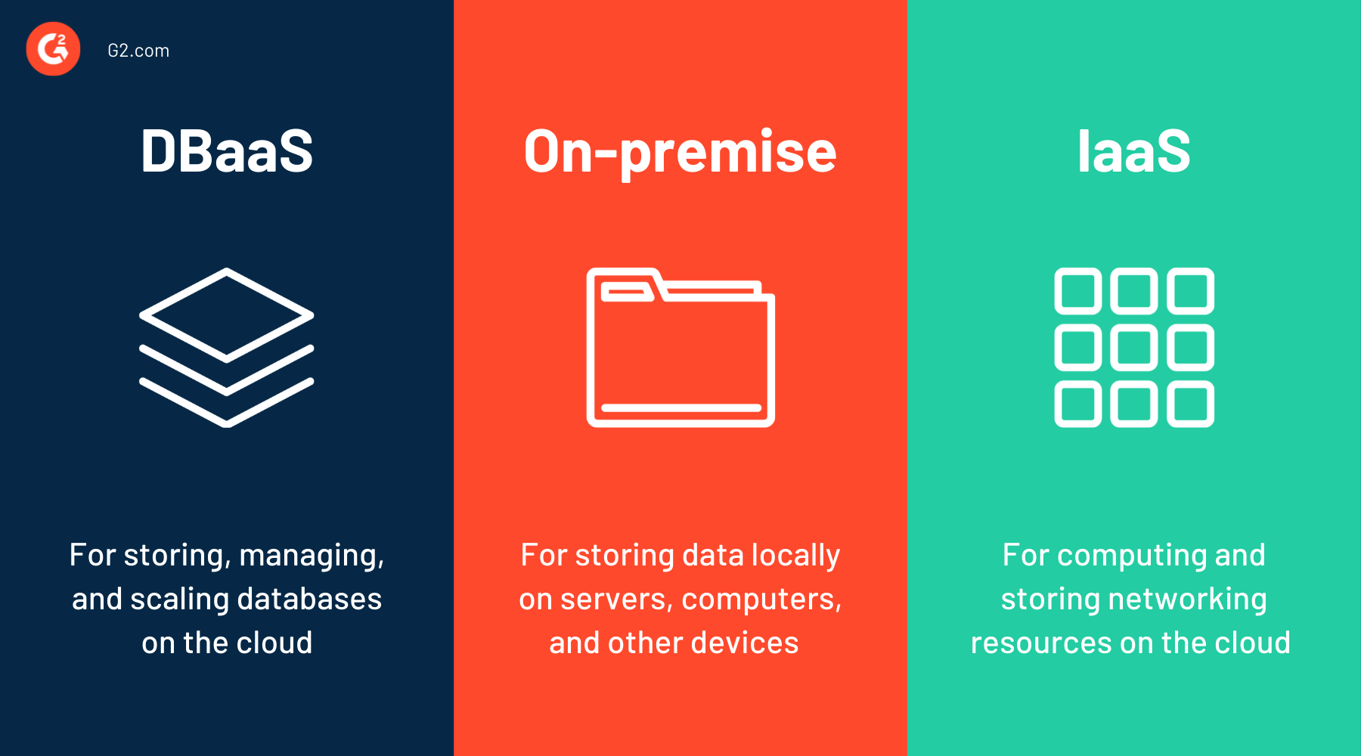
Database Services in the Cloud
1. Database as a Service (DBaaS) 2. Types of databases (SQL, NoSQL)

Slide 23
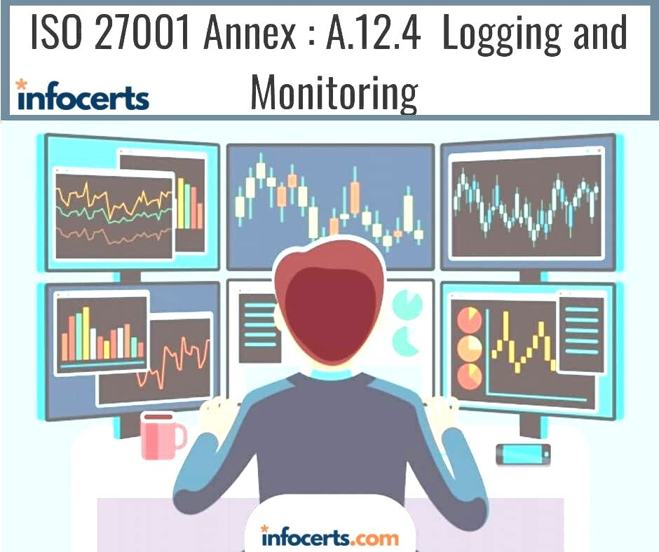
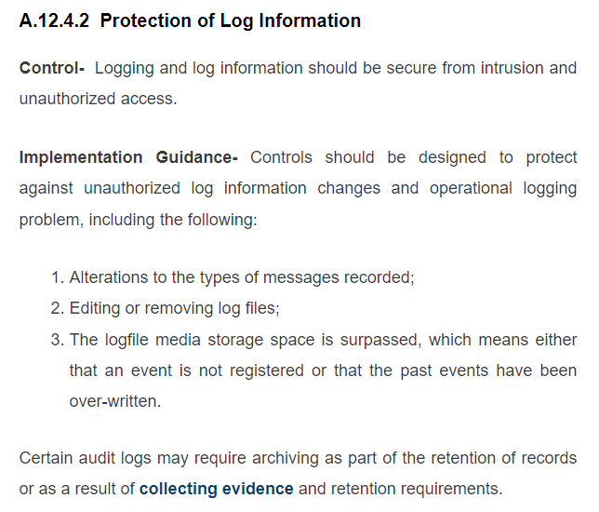
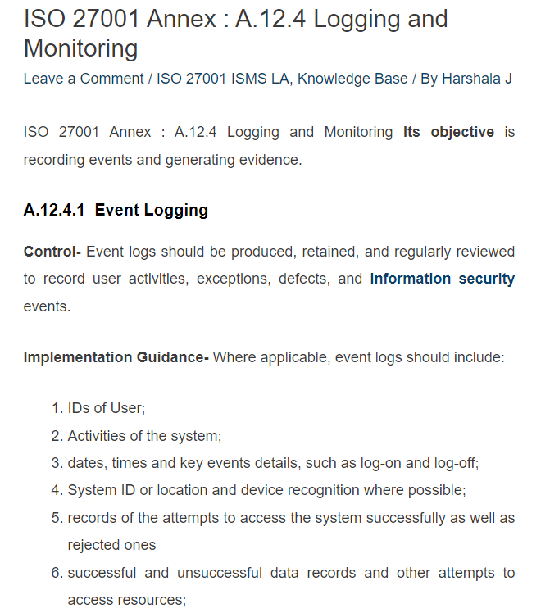
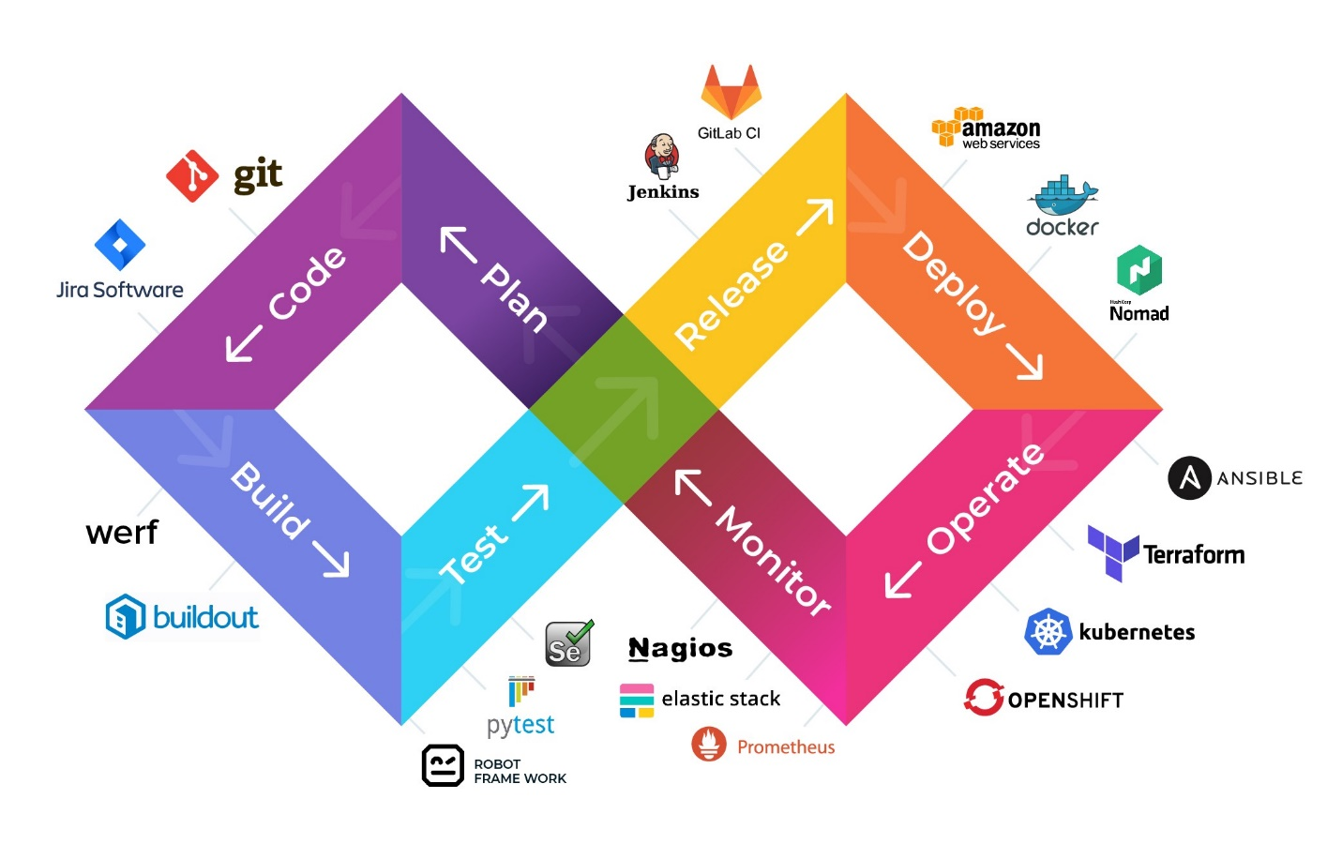
Monitoring and Logging
1. Importance of monitoring in the cloud
2. Logging and analysis tools

Slide 24
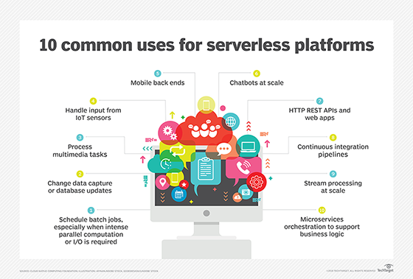
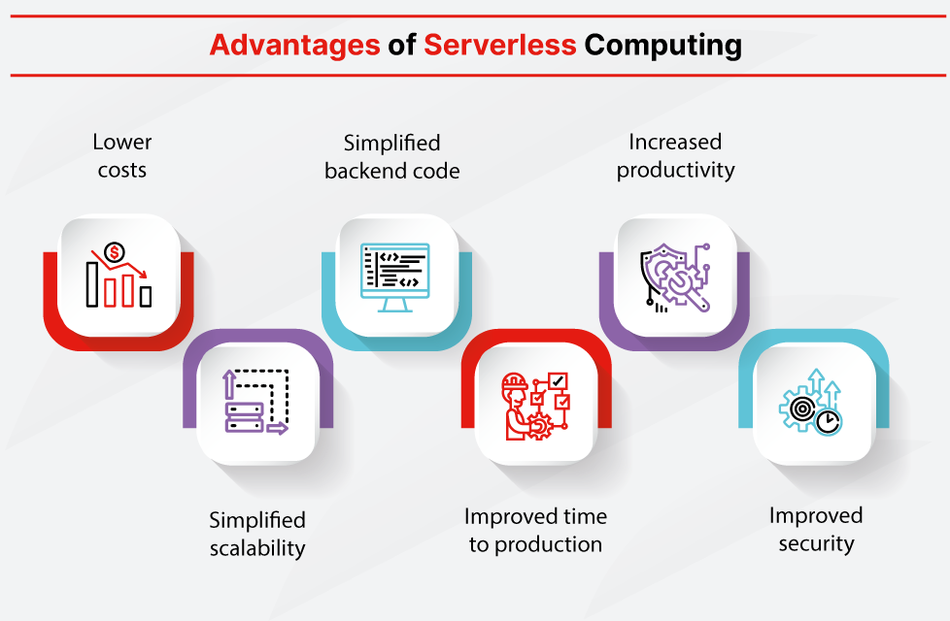
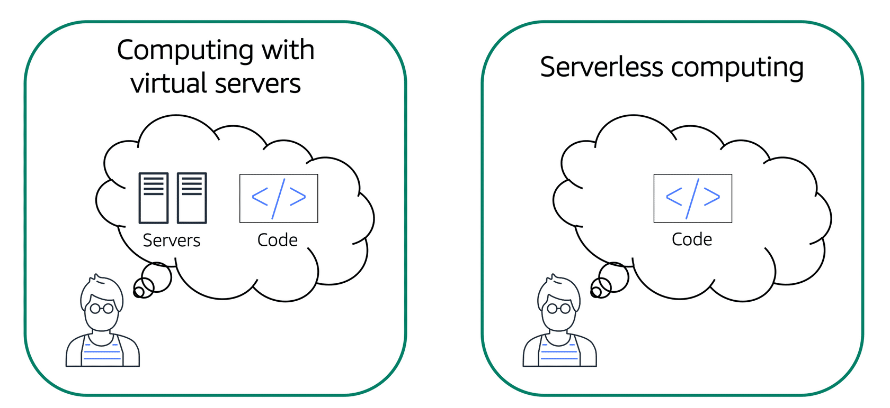
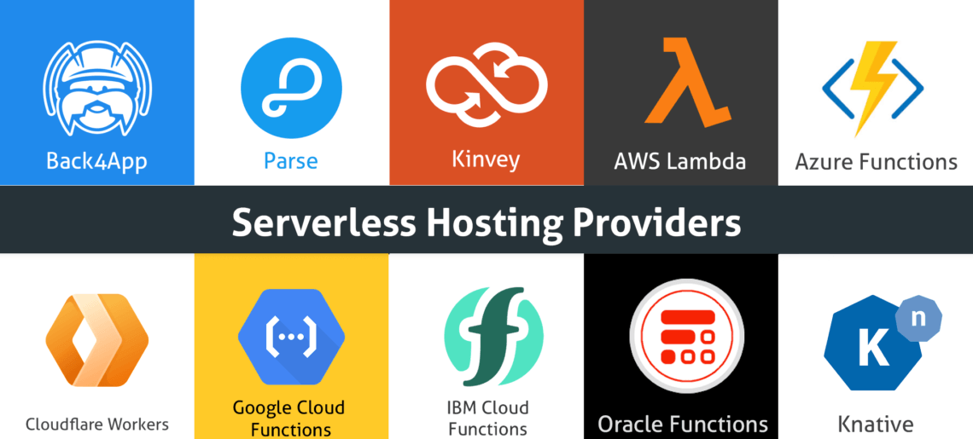
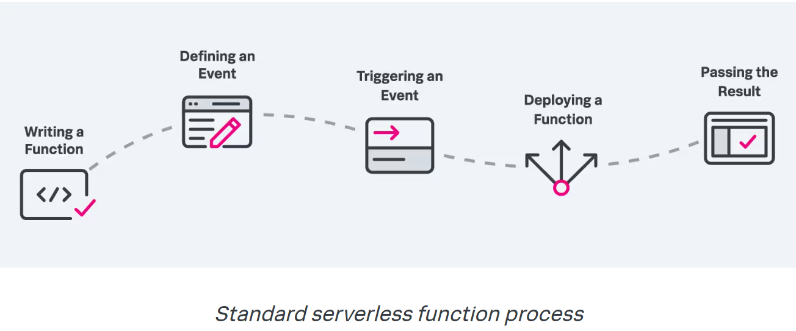
Serverless Computing
a cloud computing execution model in which the cloud provider allocates machine resources on demand, taking care of the servers on behalf of their customers
Serverless computing
https://en.wikipedia.org/wiki/Serverless_computing https://www.splunk.com/en_us/blog/learn/serverless-functions.html

Slide 25
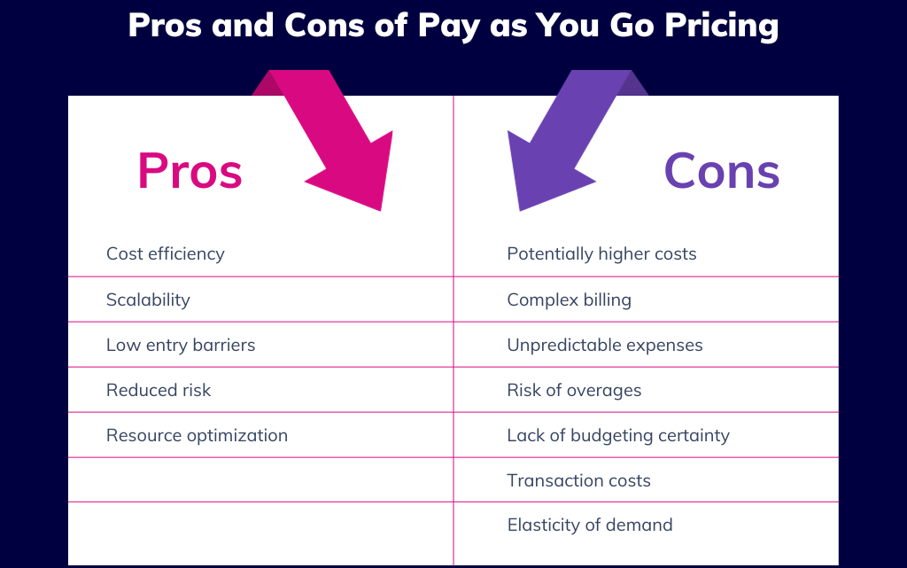
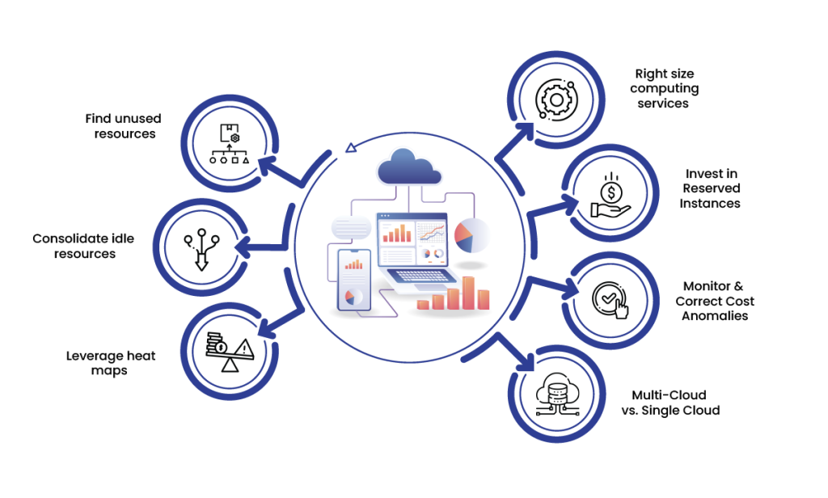
Cloud Cost Management
Cost optimization strategies
Pay-as-you-go (PAYG) cloud computing is a payment method for cloud computing that charges based on usage
PAYG in Learning/Training?

Slide 26
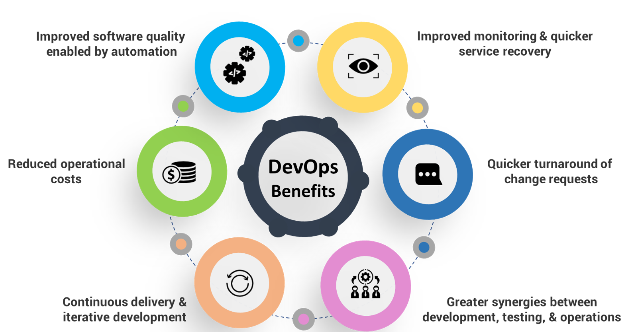
DevOps and Continuous Integration/Continuous Deployment (CI/CD)

Slide 27
LAB
TERRAFORM in CI/CD

Slide 28
END

